Slide 1
Brazilian E-Commerce DSBA 6160
Ornella Yema
Deevanshu Kishor Khatri
Tharun Kumar Bottlapally
Youlia Tzenova
Sravya Reddy Gangi
Sandhosh Murugasen

Slide 2



Use Case
Objectives
Develop a website which new or existing businesses can use in order to determine whether their products will be viable as an e-commerce offering in Brazil.
The website
The website would use existing data on Brazilian e-commerce in order to generate information which would help inform the user’s decision.
Functionalities
Generate a table of best-selling product categories in a particular state
Average price by product category in that state
Average number of months it takes a business in that state to reach its maximum number of orders
Population growth information by state to make business decisions

Slide 3
Use Case Relationships
The user:
Selects a state from a drop-down menu
Uses that selection to filter table
Queries and returns data to the user.
Screenshot

Slide 4
Pre-conditions
The user:
Should have a home state or product category in mind when exploring the possibility of expanding into e-commerce in Brazil
This home state must exist in the seller_state field of the database.
The user’s business product should also fit into the existing product categories, contained in the product_category_name_english field in the database.
The product category must have sold more than one unit in a particular state if the user is to select a state based on a product category.
Screenshot

Slide 5
Basic Flow
Use case begins when user selects a product category or state from a drop-down menu
Selected state becomes filter in SQL queries
Business rule: state must exist in database & state must have orders associated with it
Selected product becomes the parameter for the GET_STATES function, which generates the state where that product sells the most
Business rule: product category must have more than 1 order in a given state.
Website generates two tables and three KPIs, corresponding to the following:
Top 10 product categories as defined by number of products sold: This gets generated by the query “Top 10 product categories in a state”
Average product price by product category
KPI: % of customer orders shipped to seller’s state
KPI: average number of months for a business to reach max orders
KPI: population growth percentage

Slide 6
Basic Flow
Screenshot

Slide 7
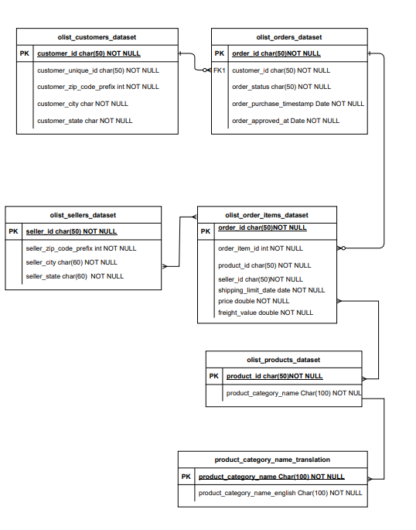
Tables: list_customers_dataset olist_orders_dataset olist_sellers_dataset olist_order_items_dataset olist_products_dataset product_category_name_translation
ERD

Slide 8
Data Dictionary: Orders & Product Datasets
Products Data Set
Variable | Description
product_id | Unique identifier for products
product_category_name | Category in which the products belong
product_name_lenght | Length of the product name
product_description_lenght | Length of product description
product_photos_qty | Number of photos of the product
product_weight_g | Weight of the product in grams
product_length_cm | Length of the product in centimeter
product_height_cm | Height of the product in centimeter
product_width_cm | Width of the product in centimeter
Orders Data Set
Variable | Description
order_id | Unique identifier for Orders
customer_id | Customer unique identification number
order_status | Status of the order whether it is delivered, cancelled, in transit, etc
order_purchase_timestamp | Timestamp at which the order is purchased
order_approved_at | Timestamp at which the order was approved
order_delivered_carrier_date | Timestamp at which the order was delivered to the carrier
order_delivered_customer_date | Timestamp at which the order was delivered to the customer
order_estimated_delivery_date | Expectecd timestamp of the delivery

Slide 9
Data Dictionary: Order Items & Customer Datasets
 | Order Items Data Set
 | Variable | Description
 | order_id | Unique identifier for Orders
 | order_item_id | Count of items
 | product_id | Unique identifier for products
 | seller_id | Unique identifier for sellers
 | shipping_limit_date | Date of Shipping
 | Price | Price of the product
 | freight_value | price at which the product is delivered
Customer Data Set
Variable | Description
Customer ID | Customer unique identification number
Customer Unique ID | Another unique identifier for customers
customer_zip_code_prefix | Zip Code of customer
customer_city | City of customer
customer_state | State of customer

Slide 10
Data Dictionary: Seller dataset & Product Category Name translation
Sellers Data Set
Variable | Description
seller_id | Unique identifier for sellers
seller_zip_code_prefix | Zip code for sellers
seller_city | City of seller
seller_state | State of seller
Product Category Name translation
Variable | Description
product_category_name | Name of the product Category
product_category_name_english | Name of the product Category in English

Slide 11
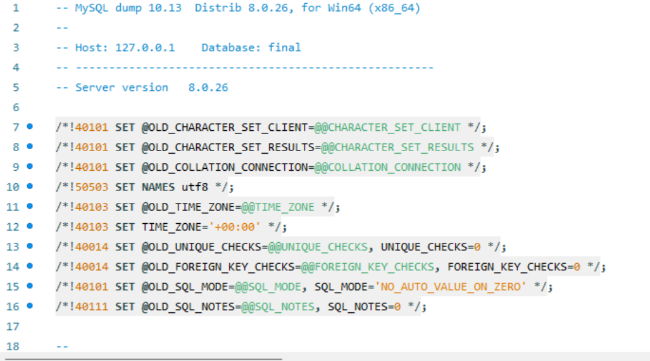
SQL Dump File

Slide 12
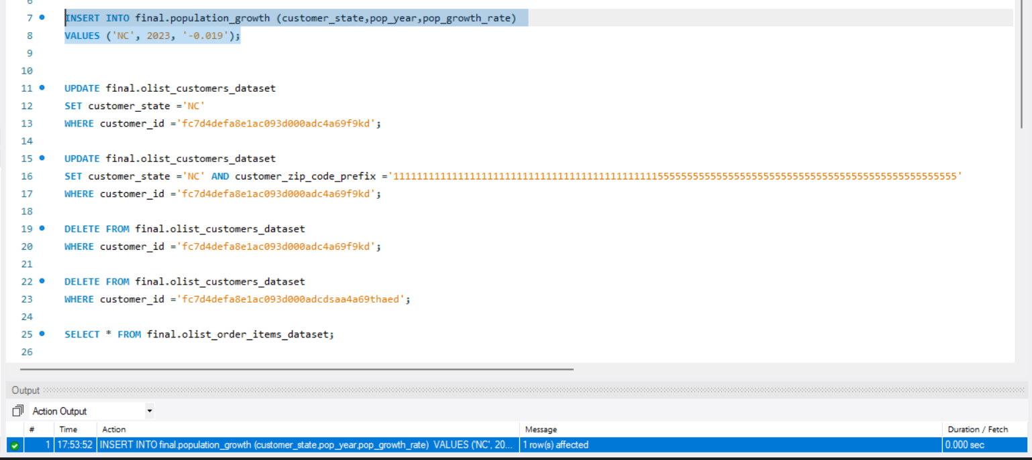
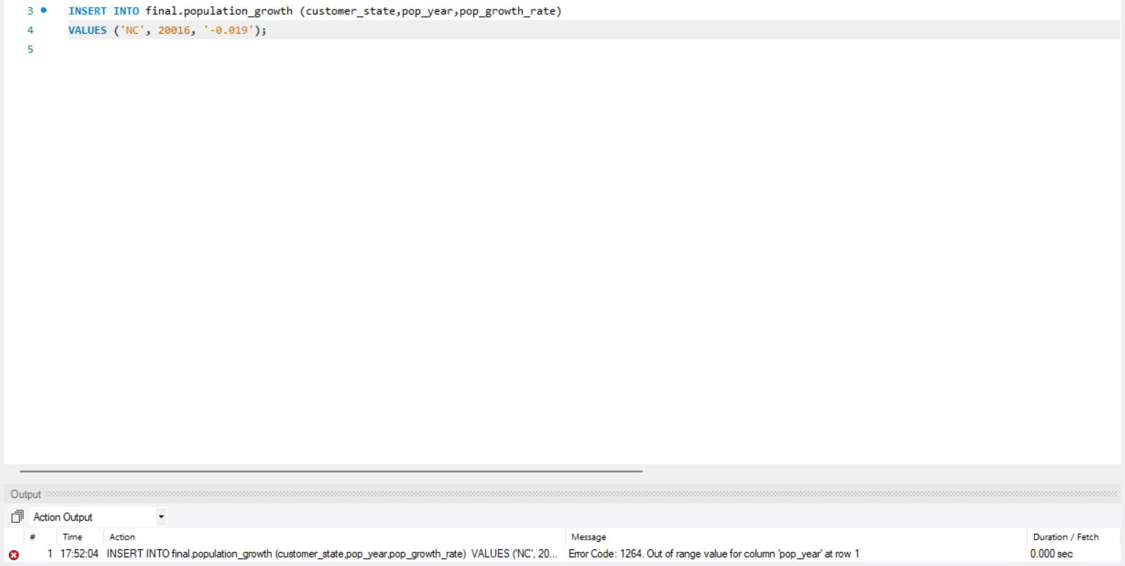
Deliverable 3: Insert data into a new row into an existing table.
Test with good data
Test with bad data
Message: INSERT INTO final.population_growth (customer_state,pop_year,pop_growth_rate) VALUES ('NC', 2023, '-0.019') 1 row(s) affected 0.000 sec
Message; INSERT INTO final.population_growth (customer_state,pop_year,pop_growth_rate) VALUES ('NC', 20016, '-0.019’) Error Code: 1264. Out of range value for column 'pop_year' at row 10.000 sec

Slide 13
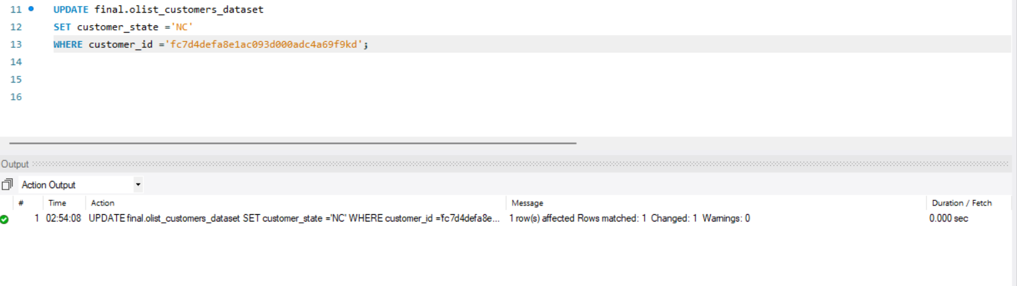
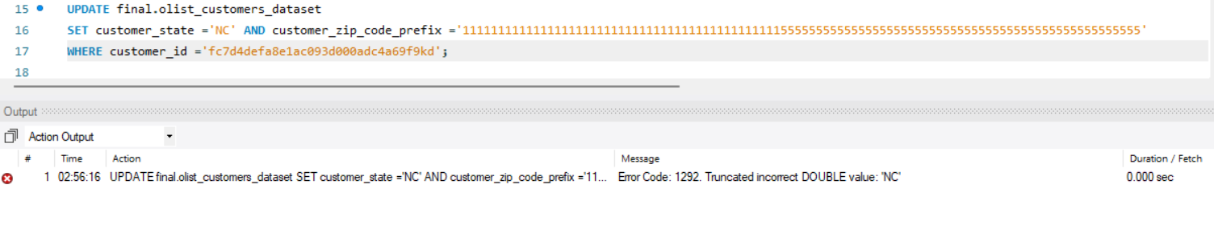
Deliverable 3: Update data in an existing row in a table.
Test with bad data
Test with good data
Message: UPDATE final.olist_customers_dataset SET customer_state ='NC' AND customer_zip_code_prefix='111111111111111111111111111111111111111111111555555555555555555555555555555555555555555555555555' WHERE customer_id ='fc7d4defa8e1ac093d000adc4a69f9kd' Error Code: 1292. Truncated incorrect DOUBLE value: 'NC' 0.000 sec
Message; UPDATE final.olist_customers_dataset SET customer_state ='NC' WHERE customer_id ='fc7d4defa8e1ac093d000adc4a69f9kd' 1 row(s) affected Rows matched: 1 Changed: 1 Warnings: 0 0.000 sec

Slide 14
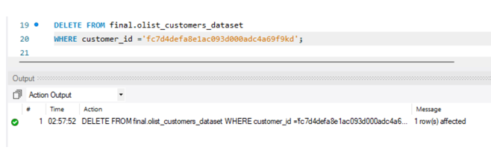
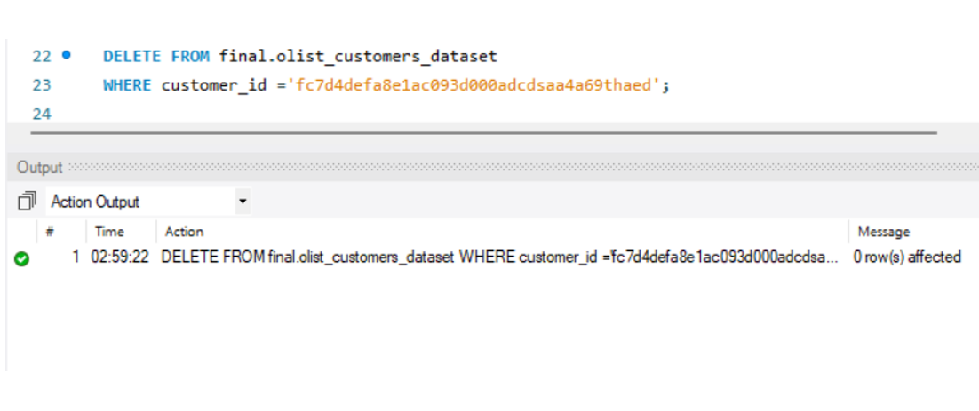
Deliverable 3: Delete data a row in a existing table
Test with good data
Test with bad data
Message: DELETE FROM final.olist_customers_dataset WHERE customer_id ='fc7d4defa8e1ac093d000adc4a69f9kd’ 1 row(s) affected 0.000 sec
Message: DELETE FROM final.olist_customers_dataset WHERE customer_id ='fc7d4defa8e1ac093d000adcdsaa4a69thaed' 0 row(s) affected 0.000 sec

Slide 15
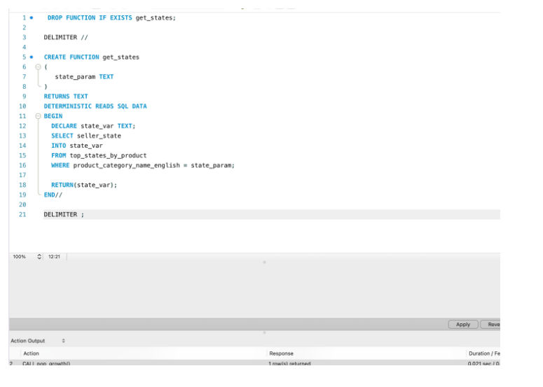
DROP FUNCTION IF EXISTS get_states; DELIMITER // CREATE FUNCTION get_states ( state_param TEXT ) RETURNS TEXT DETERMINISTIC READS SQL DATA BEGIN DECLARE state_var TEXT; SELECT seller_state INTO state_var FROM top_states_by_product WHERE product_category_name_english = state_param; RETURN(state_var); END// DELIMITER ;
Function SQL code

Slide 16
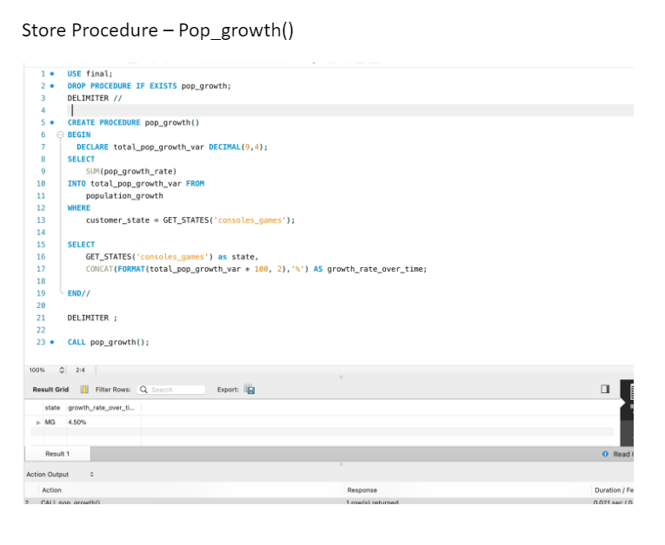
USE brazillian_dataset; DROP PROCEDURE IF EXISTS pop_growth; DELIMITER // CREATE PROCEDURE pop_growth() BEGIN DECLARE total_pop_growth_var DECIMAL(9,4); SELECT SUM(pop_growth_rate) INTO total_pop_growth_var FROM population_growth WHERE customer_state = GET_STATES('consoles_games'); SELECT GET_STATES('consoles_games') as state, CONCAT(FORMAT(total_pop_growth_var * 100, 2),'%') AS growth_rate_over_time; END// DELIMITER ; CALL pop_growth();
Procedure SQL Code

